Slide 1

PWM
許佳興
jiashing@tea.ntue.edu.tw
(視覺與感測技術應用實驗室)

Slide 2
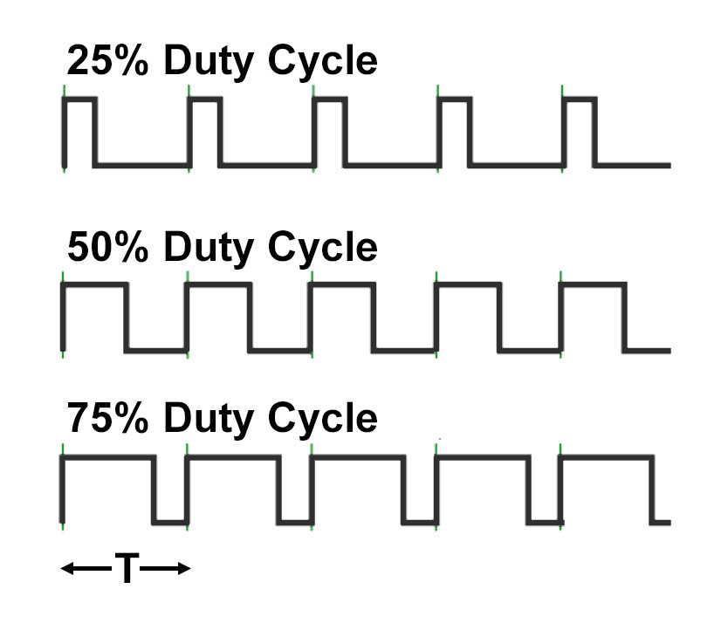
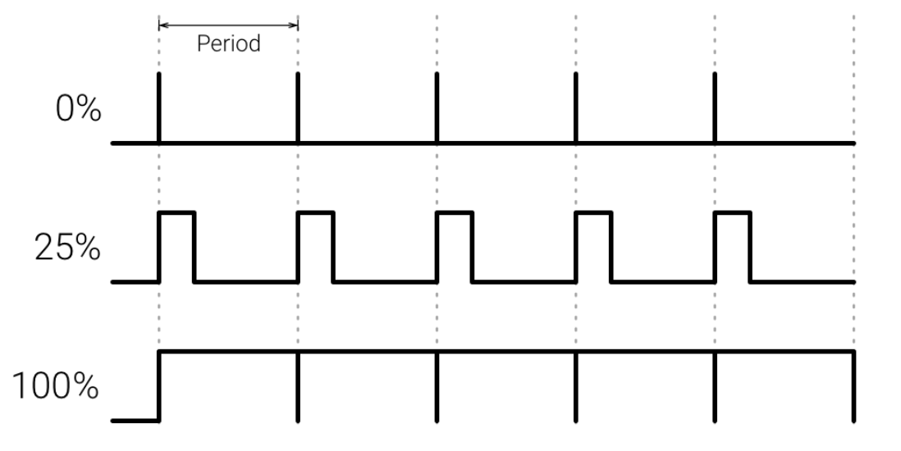
PWM
T為周期，單位為”秒” ，請另定義頻率為 f = 1/T (單位為”Hz”)

Slide 3
Rsapberry’s PWM
led = 18
GPIO.setmode(GPIO.BCM)
GPIO.setup(led, GPIO.OUT)
pwm = GPIO.PWM(led, 500)
pwm.start(25)
500 = 1/T = f, T = 1/500(秒)
25為duty cycle 25%

Slide 4
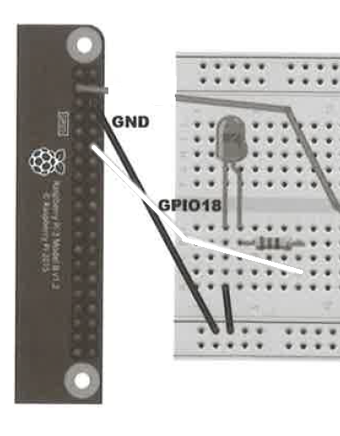
LED control using PWM (接線圖)

Slide 5
LED control using PWM pi@raspberry:~$ sudo python3 led_pwm.py
# LED Control by PWM
import RPi.GPIO as GPIO
led = 18
GPIO.setmode(GPIO.BCM)
GPIO.setup(led, GPIO.OUT)
pwm = GPIO.PWM(led, 500)
pwm.start(100)
try:
while True:
duty = int(input("Enter Brightness(0~100): "))
pwm.ChangeDutyCycle(duty)
finally:
print("Exit the program...")
GPIO.cleanup()

Slide 6
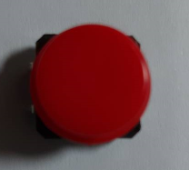
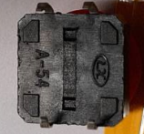
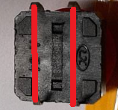

按鈕正面 按鈕背面
沒有壓按鈕時 (紅色代表相通(短路)):
壓住按鈕時 (紅色代表相通(短路)):

Slide 7
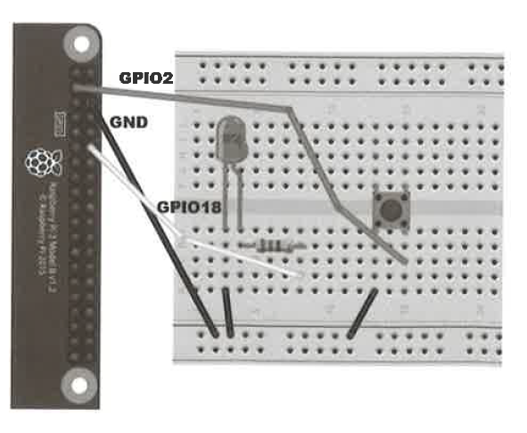
按鈕(接線圖)

Slide 8
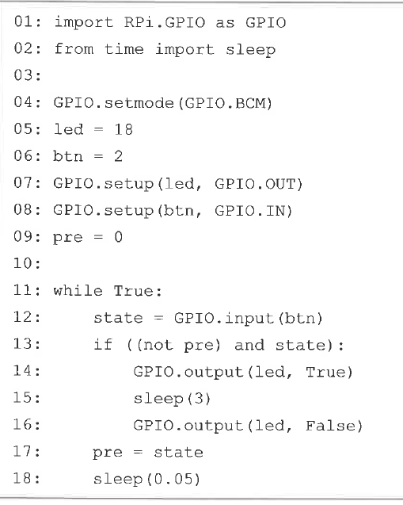
按鈕

Slide 9
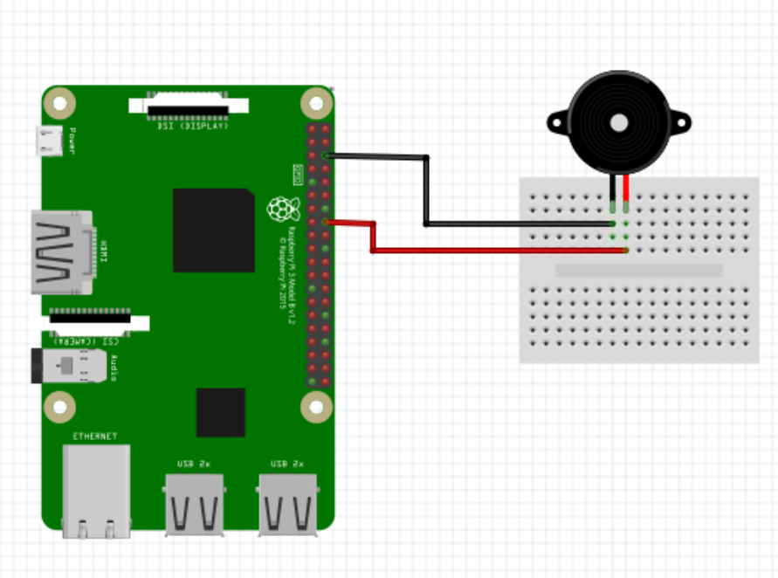
Music by Buzzer using PWM control (接線圖)

Slide 10
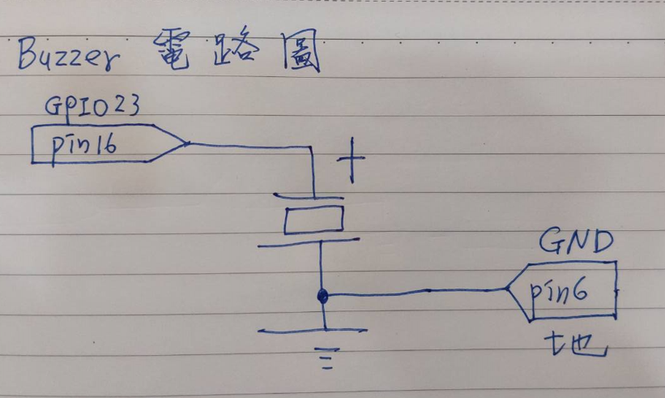
Music by Buzzer using PWM control (電路圖)

Slide 11
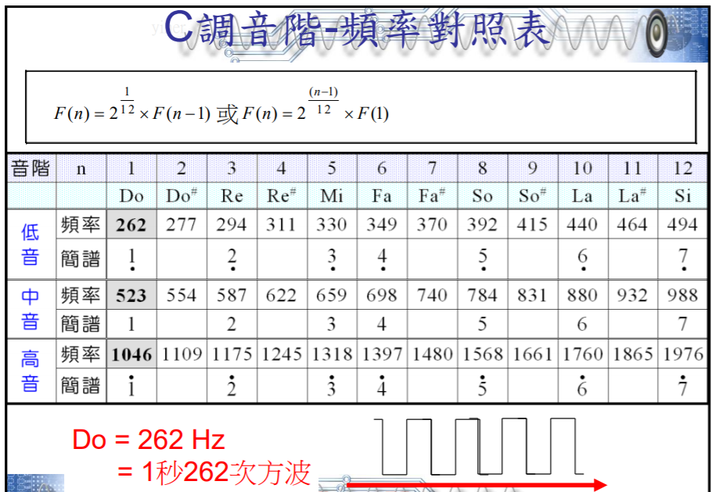

Slide 12
Music by Buzzer using PWM control
import time
import RPi.GPIO as GPIO
def doReMi(buzzerio):
GPIO.setmode(GPIO.BCM)
GPIO.setup(buzzerio, GPIO.OUT)
p = GPIO.PWM(buzzerio, 50)
p.start(50)
print("Do")
p.ChangeFrequency(523) # 523
time.sleep(10)
print("Re")
p.ChangeFrequency(587) #587
time.sleep(10)
print("Mi")
p.ChangeFrequency(659)
time.sleep(10)
p.stop()
GPIO.cleanup()
doReMi(23)

Slide 13
參考資料
https://s761111.gitbook.io/raspi-sensor/feng-qi

Slide 14
Q&A

